Slide 1
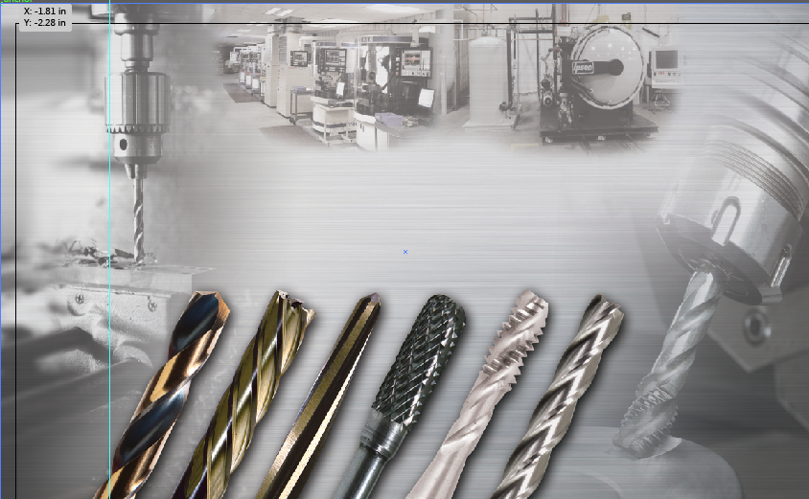
Module 1
MILLING

Slide 2
WHAT IS AN END MILL?
An endmill is a type of milling cutter. They are sometimes referred to as simply “cutters” or “slot drills”
Used in industrial milling applications
It is distinguished from the drill bit in its application, geometry, and manufacture.
While a drill bit can only cut in the axial direction, a milling bit can generally cut in all directions, though some cannot cut axially.
Endmills are used in milling applications such as profile milling, tracer milling, face milling, and plunging.

Slide 3
CHOOSING THE RIGHT END MILL
A wide range of options & considerations:
High Speed Steel (HSS)
High Speed Cobalt (HSCo)
Powdered Metal (PM)
Solid Carbide
Coated (AlTiN) or Un-coated (Bright)
Square End vs. Ball Nose
Center Cutting vs. Non-Center Cutting
Single End vs. Double End
Shank type

Slide 4
CHOOSING THE RIGHT PRODUCT
Things to consider:
The workpiece material, including hardness
The tool path (i.e slotting)
Wet or dry application
Number of pieces to be produced
Manual or power feed
The machine: age, style, strength, condition, horsepower, rigidity, spindle speed

Slide 5
SUBSTRATE COMPARISON
1. High Speed Steel (HSS) & Cobalt (HSCo)
Low cost
Tough
Versatile
Shock absorbing
Increased heat and wear resistance with Cobalt vs. HSS
2. Powdered Metal (PM)
Higher tool cost (than HSS/HSCo)
Tougher and harder than HSS
Most shock resistant
Versatile
Great for high temp alloys (Inconel, Waspalloy)

Slide 6
SUBSTRATE COMPARISON
3. SOLID CABIDE
Hardest Material
Most wear resistant
Highest cost, especially on larger sizes
Most brittle
Longest tool life
High productivity and faster operating parameters (up to 2.5 x that of HSS)
Usually the best value for your money in most applications

Slide 7
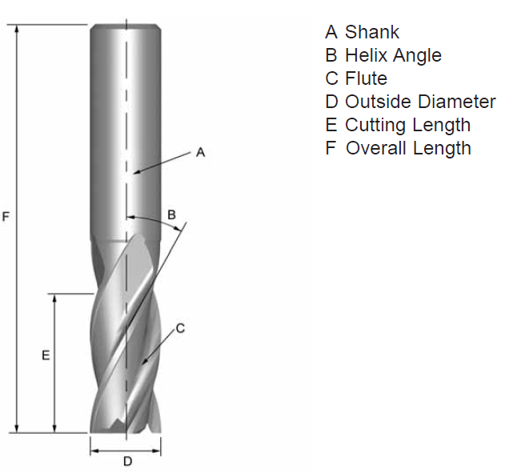
BASIC END MILL NOMENCLATURE

Slide 8
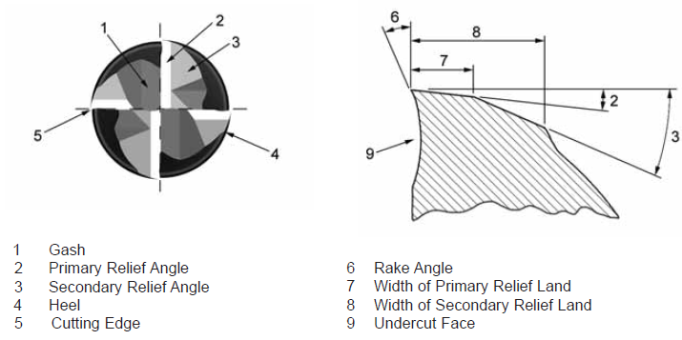
BASIC END MILL NOMENCLATURE

Slide 9
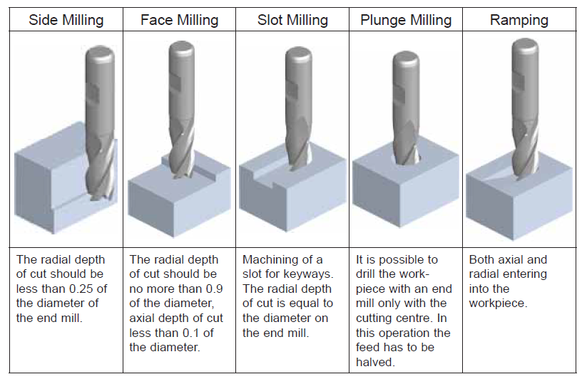
TYPES OF MILLING

Slide 10
HOW MANY FLUTES?
Selecting the correct number of flutes to use is dependent on:
The material you are milling
Dimension of the workpiece
Milling conditions
The table on the next slide is a guide to selecting the correct number of flutes.

Slide 11
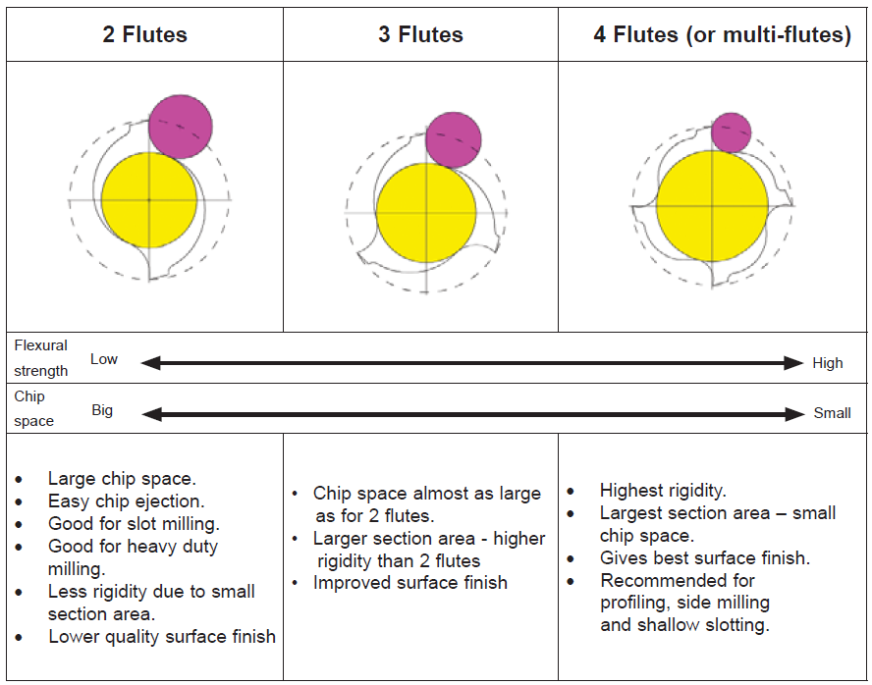
HOW MANY FLUTES?

Slide 12
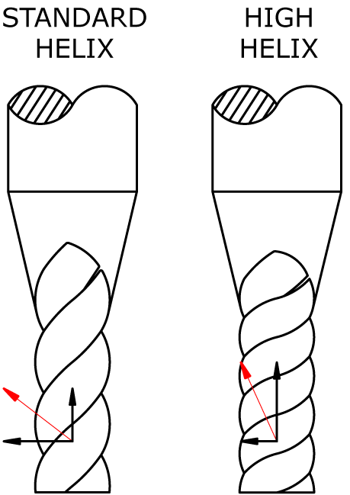
HELIX ANGLES
30° or 45 °?
30° is the industry standard helix angle
A higher helix angle (45°) reduces tool deflection by redirecting the cutting forces from a horizontal to a vertical direction
Higher helix angle removes material quickly. Ideal for use in materials such as aluminum and other non-ferrrous materials.

Slide 13
SINGLE VS. DOUBLE END
SINGLE OR DOUBLE END?
Single end are the most commonly used end mills
Double end End Mills have two cutting ends on the same tool. Both ends can be used to cut, which can reduce tool cost
Endmill holders must have sufficient clearance to allow for the use of a double end cutter

Slide 14
BALL NOSE END MILL
WHY A BALL NOSE END MILL?
The end of the end mills are hemispherical.
They are ideal for machining 3-dimensional contoured shapes in machining centres, for example in molds and dies.
Also used to add a radius between perpendicular faces to reduce stress concentrations.

Slide 15
ROUGHING END MILL
WHY A ROUGHING END MILL?
Roughing end mills quickly remove large amounts of material.
Utilizes a wavy tooth form cut on the periphery. These teeth form many successive cutting edges producing many small chips, resulting in a relatively rough surface finish.
During cutting, multiple teeth are in contact with the workpiece reducing chatter and vibration.
Almost always made of Cobalt or Powdered Metal

Slide 16
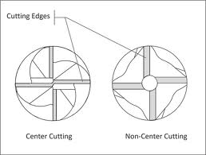
CENTER CUTTING
CENTER CUTTING vs. NON-CENTER CUTTING
Center cutting are by far the most common type
Non-Center Cutting end mills should only be used for side milling operations

Slide 17
SHANK TYPES
There are 2 common shank types in end mills:
Weldon Shank
Simple clamping, without tuning of the cutting length
Good capacity of torque transmission in roughing operations
Plain Shank
Good choice for very small diameters
Adjustable tool length
No unbalance at high speeds (no flat, no screw)
Suitable for precision clamping or shrink fitting

Slide 18
FORMULAE
Below are the most common terms and formulas when it comes to end milling:
SFM – Surface feet per Minute
RPM - Revolutions per Minute
F – Feed in Inches per Minute
Ft – Feed per Tooth
D – Cutting Diameter
T - Number of Teeth
SFM = D x RPM x .26
RPM = SFM x 3.82
D
F = Ft x T x RPM
Ft = F(Feed)
T x RPM

Slide 19
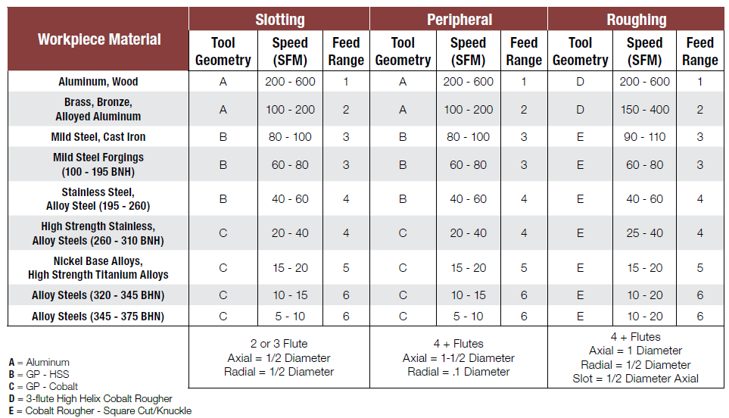
END MILLS FEEDS AND SPEEDS
Data from 2013 Drillco Product Catalog

Slide 20
END MILLS FEEDS AND SPEEDS
Data from 2013 Drillco Product Catalog

Slide 21
TROUBLESHOOTING
Tool Breakage | Solution
Feed is too heavy | Reduce Feed Rate
Cut is too heavy | Decrease width and depth of cut
Too much tool overhang | Use shorter tool, hold shank deeper
Too much wear | Regrind tool at earlier stage
Excessive Wear | Solution
Speed is too fast | Decrease spindle speed
Hard work Material | Use a coated tool
Recutting of chips | Change chip size, use high pressure coolant
Chipped Cutting Edge | Solution
Lack of Rigidity | Change machine type or workpiece fixturing
Tool corner too sharp | Use corner radius or corner prep

